Slide 1
nWire Definition Extraction tool user manual
oliver.ou@teradyne.com
cam.shi@teradyne.com

Slide 2
Agenda
1. How to use
2. Features

Slide 3


How to use 1
Step 1: double click the .exe file to install the software.
Step 2: A new shortcut will appear on desktop. Open it.

Slide 4
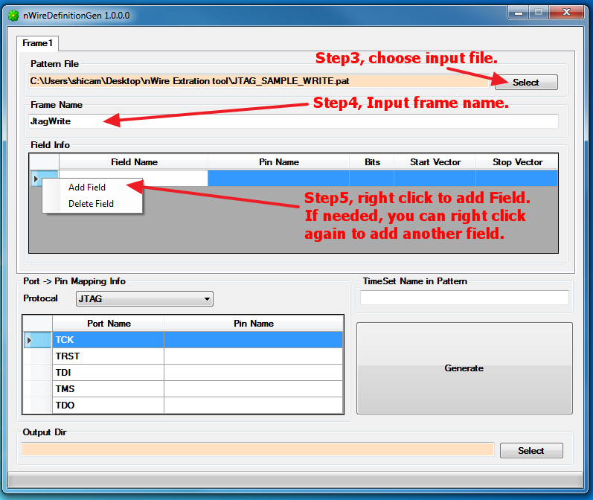
How to use 2

Slide 5
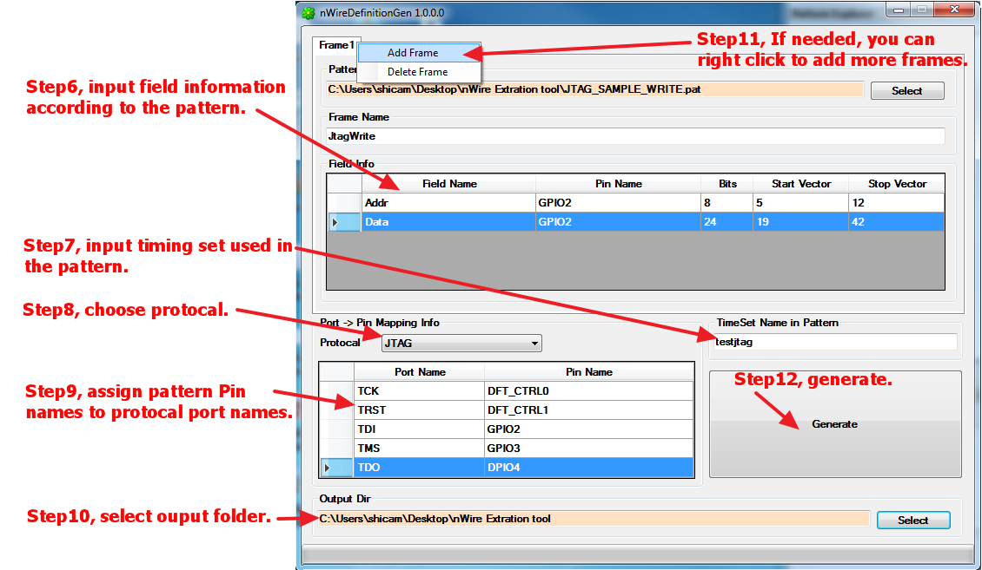
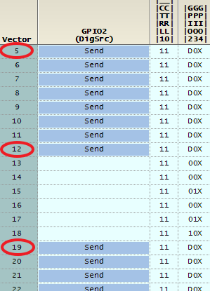
How to use 3

Slide 6
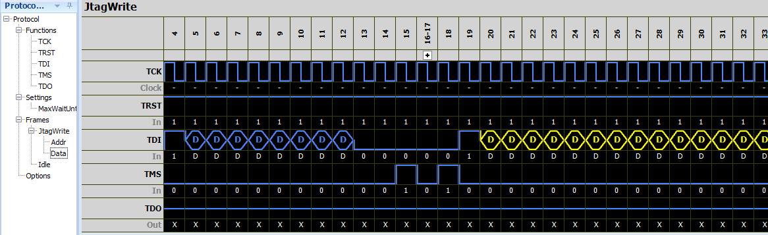
How to use 4
Step13, open xml file and review.

Slide 7
Features 1
1. Idle frame will be created automatically. It is made from the last vector of the pattern.
2. All input values are not case sensitive.
3. Only support patterns with one timing set.
4. “call” command and subroutines will be ignored.
5. The tool can support up to 5 frames.
6. For clock pins, if pattern data is “1”, xml data will be “-” (pulse low).
7. If pattern data is “V”, xml data will be “E”.

Slide 8
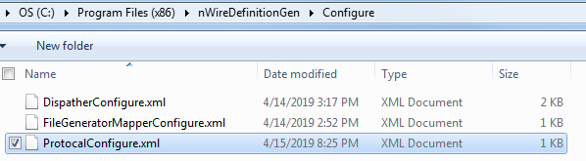
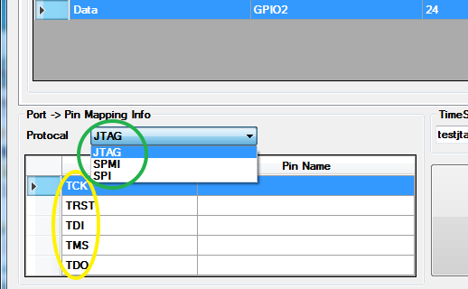
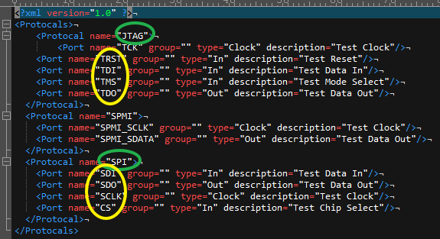
Features 2
8. protocols and pins are configured by the setting file.
C:\Program Files (x86)\nWireDefinitionGen\Configure\ProtocalConfigure.xml

